Slide 1


Smart Lock Internet of things
TEAM OF 2
THOMAs nathan
NGUYEn Luc-éric

Slide 2


TEAM OF 2
THOMAs nathan
NGUYEN
LUC-ÉRIC

Slide 3
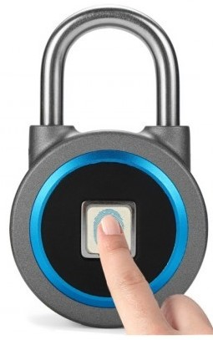
Our objective
A Fingerprint door lock connected :
More secure
Easy to modify
Accessible

Slide 4

State of Art
Reminder : What is a Smart Lock ?

Slide 5

Smarlock Definition
Connected locks make it possible to open the door of a house thanks to a smartphone and an internet or Bluetooth connection.
Instead of opening with a physical key, these locks open remotely via a secure mobile application, or by sending notifications after a fingerprint has been read.

Slide 6
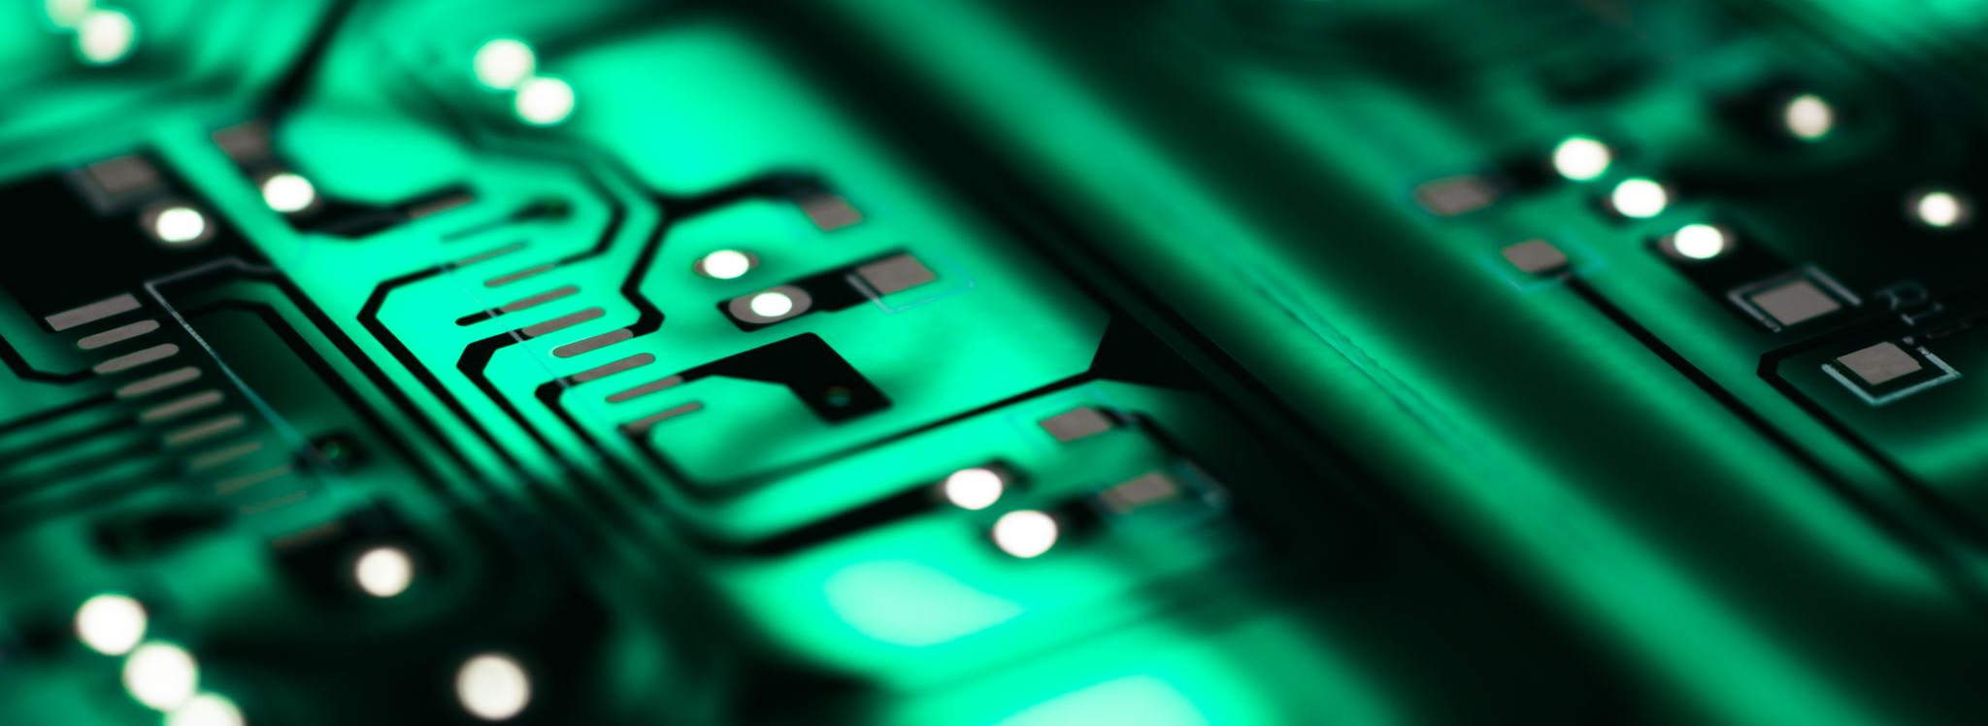
Technologies used by locks

Slide 7

Bluetooth
The great advantage of Bluetooth as a transmission standard for smart locks is its low power consumption.
Since smart locks are mostly battery-powered, power consumption cannot be neglected. Unlocking is only possible via Bluetooth over short distances.

Slide 8

Z-Wave
Z-Wave is a transmission standard that was developed specifically for Home Automation and is used for communication between different electronic devices.
Can only communicate via another standard with Z-Wave. Their range can be significantly higher when using several devices in the house rather than using Bluetooth2.

Slide 9
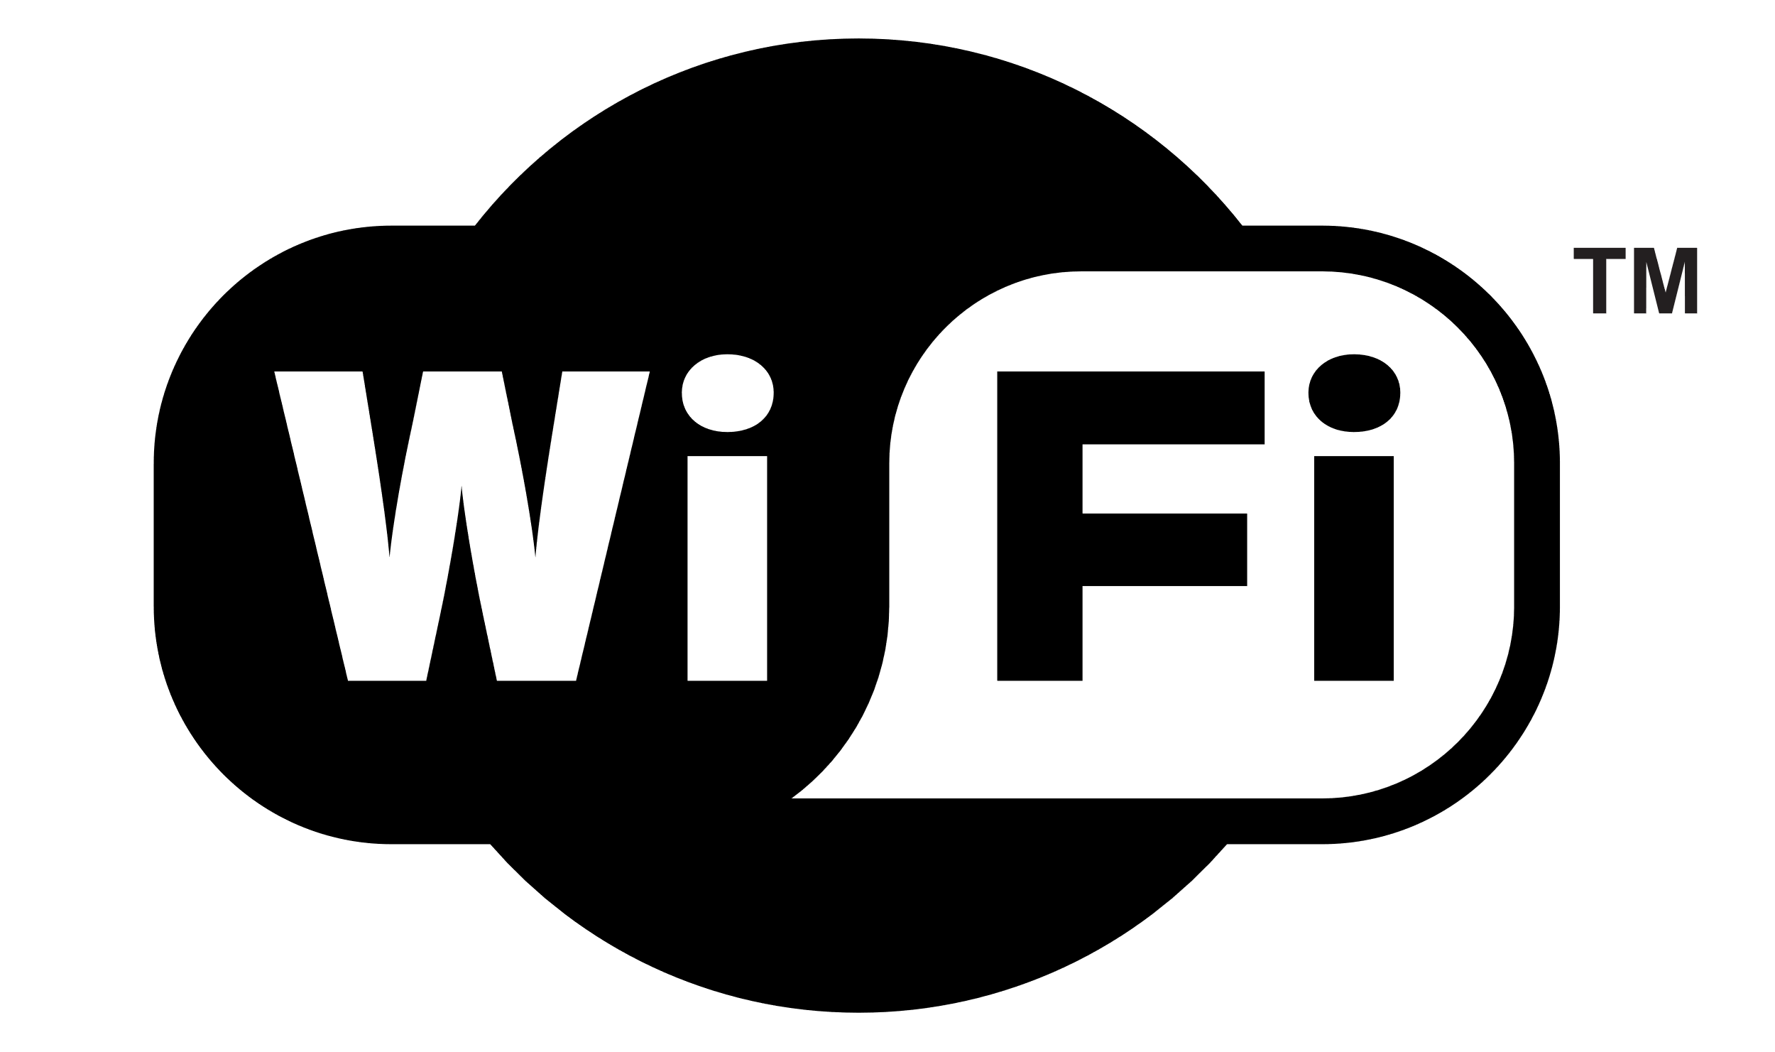
Smart locks directly connected to a Wifi router are not really common.
In addition to operating over the Internet, another advantage is that smart locks with WiFi support can also be operated using intelligent personal assistants ("Smart Assistants") such as Google Home, Amazon Echo or Siri3.

Slide 10
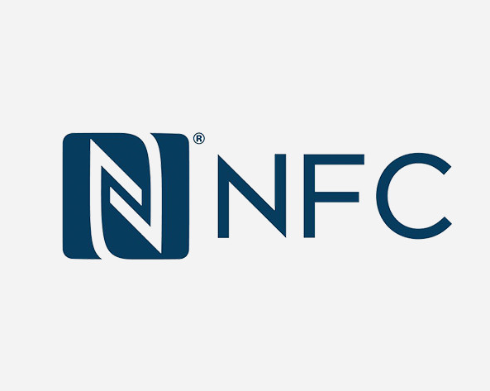
Smart locks under development use NFC for transmission.
The advantage is that the smart locks themselves no longer require a power supply.
But are able to use the induction energy of the smartphone.
In this case, the smartphone scans the RFID tag integrated in the smart lock.

Slide 11
Selection Criteria
The use
Personal housing
Rental to individuals
Work premises
Work desk
Company
The taste
Modern
Discreet
Imposing
Round shape
Rectangular shape
The budget
Minimun 100$
If not = problems
The technology
Bluetooth
Wifi
Z-wave
NFC

Slide 12

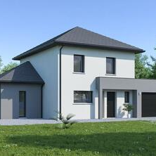
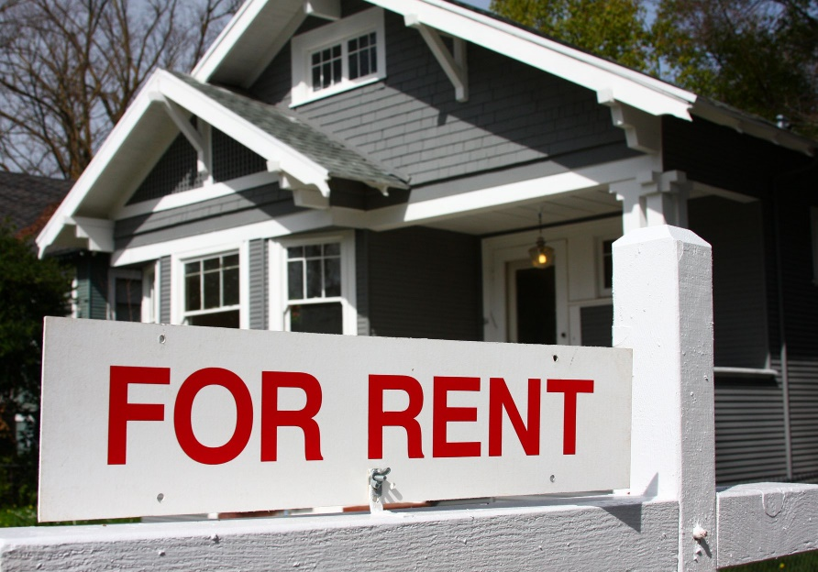
What mAKes OUR project different ?
Company
House
Rented house
Use for Company, House or rented properties
Strong Point = Low production cost = Small price
It is a security product accessible to all
Finally, nowadays everyone dreams of having their own smart lock.

Slide 13


Contest on the market

Slide 14


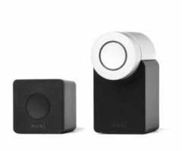
NUKI Combo
Advantages
Simple operation
Highly functional application
All-purpose design
Disadvantages
But price not accessible to all
The best smart lock in 2020. With more than 65 employees, it is a leader on the European market and a partner with large companies such as Apple, Google and Airbnb.
Already sold 100,000 copies in 2019. A bright future for this firm.

Slide 15
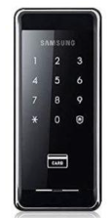
Samsung SHS2920
Advantages
Wide range of functionalities
Several means of access
Cheap
Disadvantages
But no guarantee
The brand is known for its smartphones, tablets and televisions, but it is also a leader in this field. Possess many means of access

Slide 16
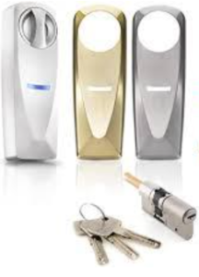
SOMFY
Advantages
Modern design in several variations
Easy to use (even for a child)
Easy installation
Disadvantages
Nothing
Easy to use product with free application provided and very intuitive with classic functionalities. Can be accessed by up to 20 users with either permanent or temporary access. Provided with 3 keys in case of problem.

Slide 17

Problem Definition
Many problems:
Improve security and comfort
Practical part
A good point for ecology
Design for everyone

Slide 18

Challenge & Motivation

Slide 19
Why this project ?
We decided to take this subject as if it were a challenge.
We want greater equity in household safety. That our product can be used the most would make us very proud.
Moreover, the real challenge for us is to introduce the fingerprint reader with the lock. Because for us this is a very complex task to achieve in an IoT project.
Moreover, we really wanted to carry out this project because it could represent a first model with points of improvement and a better budget for our own personal use.
No more need to have a key pair to access a certain door is really great in our opinion.

Slide 20
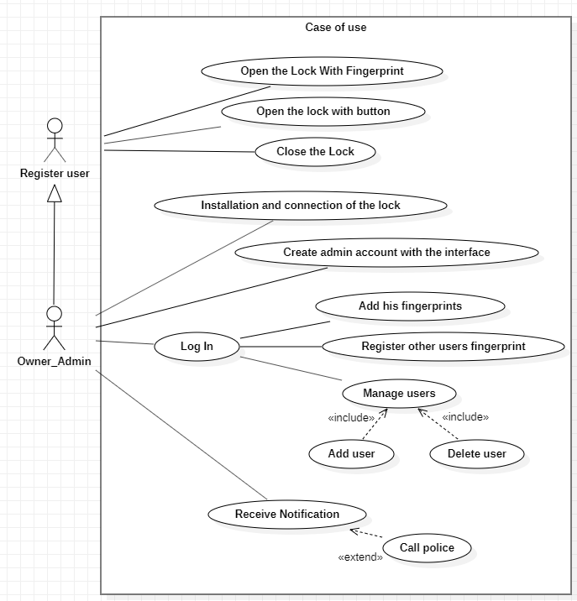
Real & complete Usecase
2 type of users : Regular and admin
Admin have the rights of regular people and rights to manage each ID

Slide 21
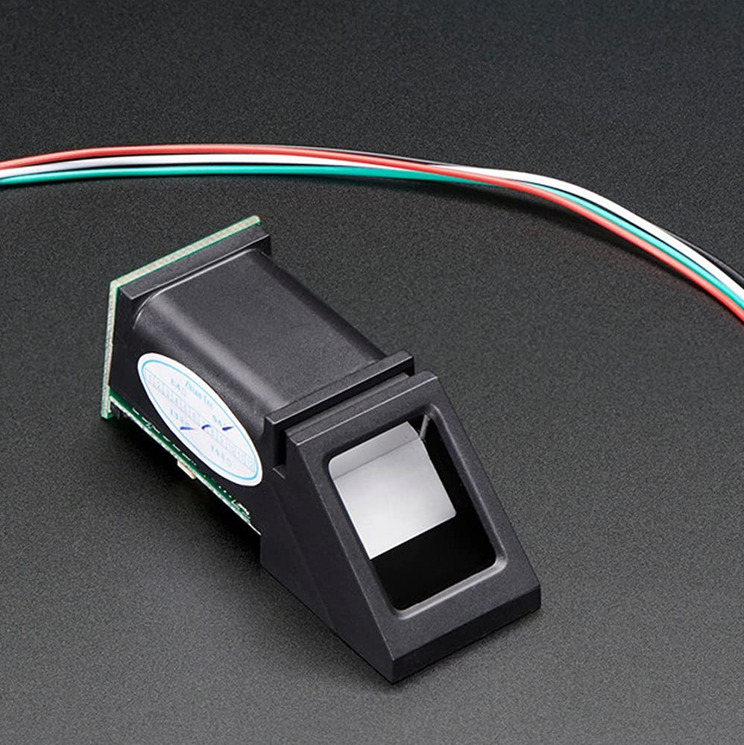
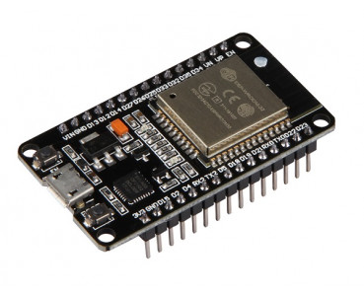
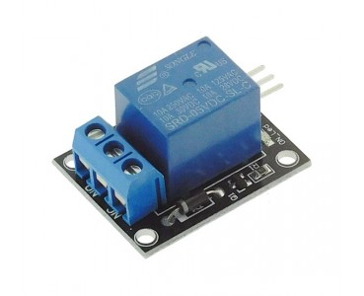
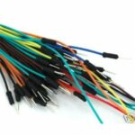
HARDWARE
Fingerprint Sensor
ESP32
Relay 5V
Jumper Wire

Slide 22
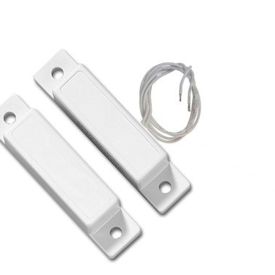
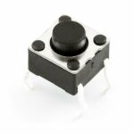
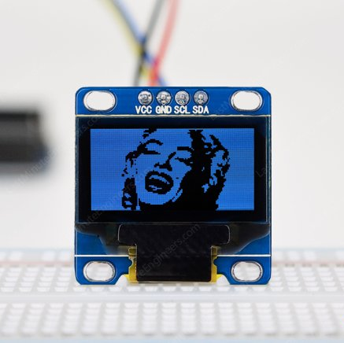
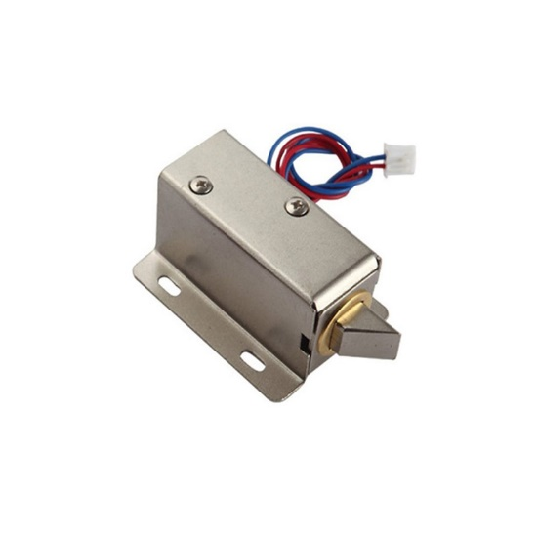
HARDWARE
Door Sensor
Push Button
LCD OLED L2C
Solénoïde ( Lock ) DC 5V

Slide 23

Technical description
First program to add fingerprint
-> example from library
Second program to delete fingerprint
-> example from library
ID are hard coded in the main program

Slide 24
TECHNICAL DESCRIPTION
Classical setup with library, Serial and Wifi part
Loop in three main parts :
To check the door sensor
To check the inside button
To check the fingerprint system

Slide 25


TECHNICAL DESCRIPTION
IFTTT to create trigger
one to update a Gsheet to keep an historic (fingerprint module)
the second to send mail (door sensor module)

Slide 26

Code & Contributions

Slide 27
WHAt does our code do
Add / delete fingerprint
Manage lock with fingerprint & push Button
Display informations on the LCD
Send an email notifications
Historic of the lock on a google sheet in real time

Slide 28
Contribution
Implementation fingerprint's system
Think about software part at the begin
Manage IFTTT part
Connection & Communication between all elements
Notification System
Film processes of each steps of the project for the video
Preparation presentation

Slide 29
Contribution
Design the smartlock model
Think about hardware part at the begin
Connection between ESP32 and other elements
Fritzing to help before assembly of our project
Software for the smartlock with Nathan
Video montage
Preparation presentation
Report with the help of Nathan

Slide 30

Demo

Slide 31



ANY QUESTION

